Slide 1
Final Project: IMDb Dataset
Toby Chappell

Slide 2
Project Description
Data visualization in Tableau of movies released after the year 2000 with the ability to drill down into the data
Backend written in Python to add and delete records of movies and people

Slide 3
Data Source
The data is taken from IMDb’s datasets which can be downloaded from the following link: https://datasets.imdbws.com/
The data consists of seven TSV files: Title Basics, Name Basics, Akas, Ratings, Principles, Crew, and Episode. Information about the tables and attributes are available through the following link: https://www.imdb.com/interfaces/
Due to the fact the Google Cloud Platform requires a CSV file format to upload into a MySQL server, the data was converted TSV into CSV files using a script I created named “upload.py.”

Slide 4
Schema
The schema based on the original tables is called “imdb_database.sql”
To allow for faster operation, the data has been filtered based on the following criteria:
Video Type = Movie
Release Date = 2000-2020
Language = English
People = Limited to 10,000 records
The filtered schema (including insert operations) is called “imdb_filtered.sql”

Slide 5
Backend
The backend of the project supports the addition/deletion of title records and name records as well performing error checking on user-inputted values
The backend python script is called ”imdb_backend.py”

Slide 6
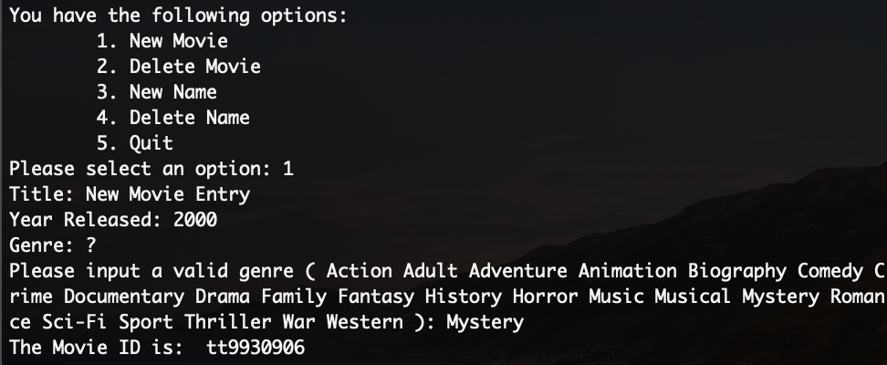
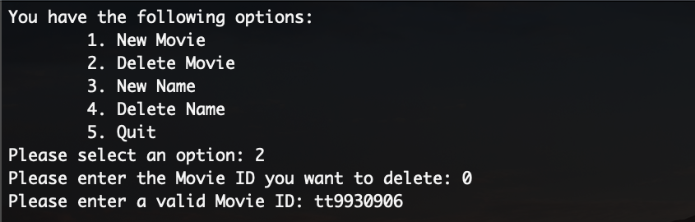
Backend – Title Operations

Slide 7
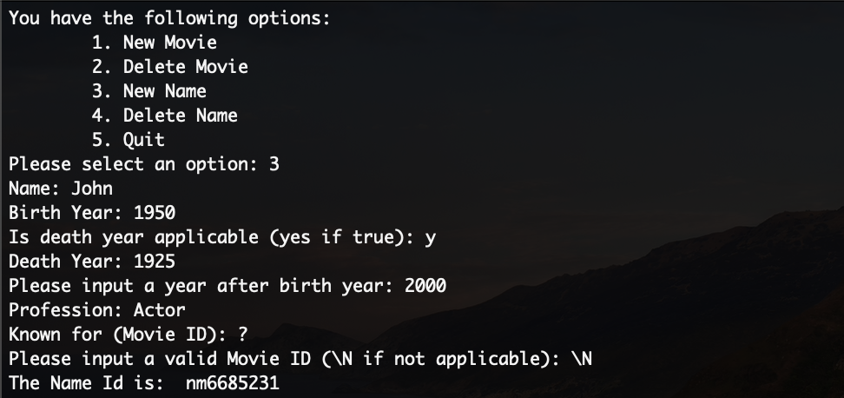
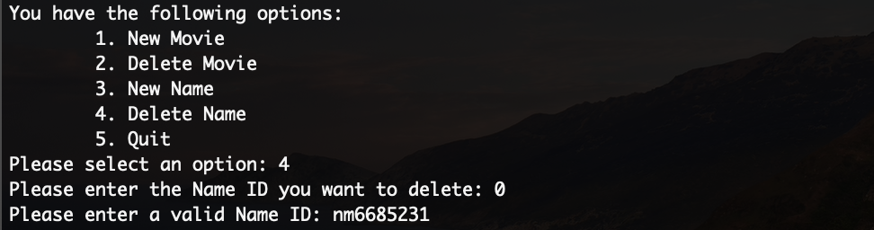
Backend – Name Operations

Slide 8
Tableau
The tableau file is called ”imdb_tableau.twb”
Consists of four main dashboards as well as two additional dashboards which provide alternate views on the data

Slide 9
Tableau - Genre
Main dashboard of the project
Displays the number of movies made after the year 2000 by genre
To simplify implementation, if a movie is given multiple genres then only the first is used
Tooltip displays genre and number of movies in that genre
If section of pie chart is clicked, the user is taken to another dashboard filtered by that genre

Slide 10
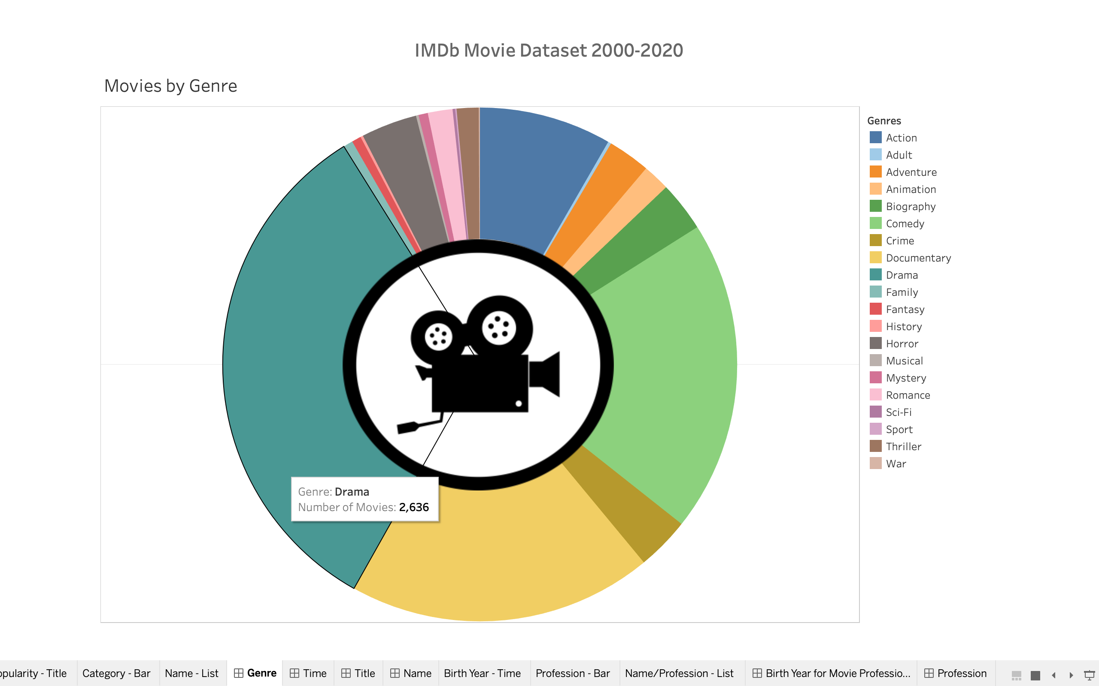

Slide 11
Tableau - Time
Once a genre is clicked on from the previous dashboard, the user is taken to this dashboard
Genre displayed in title to clarify which data is being viewed
Dashboard consists of the popularity of a genre over time as well as the number of movies made in that genre over time
Popularity calculated by the modulo (to limit data from spiking too heavily) of the number of votes multiplied by the rating
Tooltip displays year and number of movies made in that year
If a year is selected, the user is taken to another dashboard filtered by that year (and genre)
User can go back to the previous dashboard by clicking on the button at the top of the dashboard

Slide 12
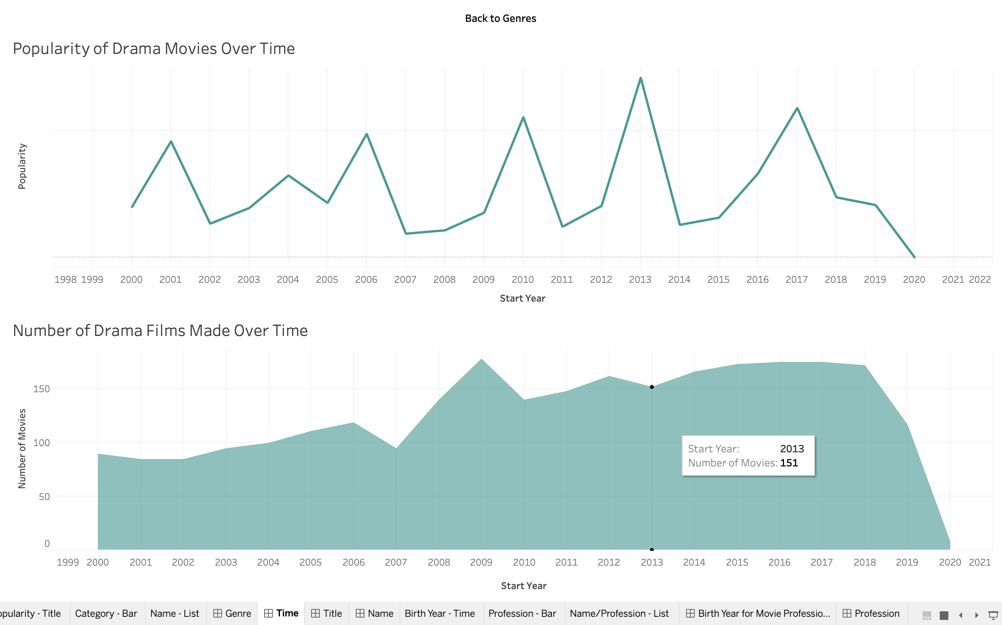

Slide 13
Tableau - Title
Once a year is clicked on from the previous dashboard, the user is taken to this dashboard
Genre and year displayed in title to clarify which data is being viewed
Dashboard consists of the titles by popularity within a given genre and year
Tooltip displays title of the movie
If a title is selected, the user is taken to another dashboard filtered by that title
User can go back to any of the previous dashboards by clicking on the buttons at the top of the dashboard

Slide 14
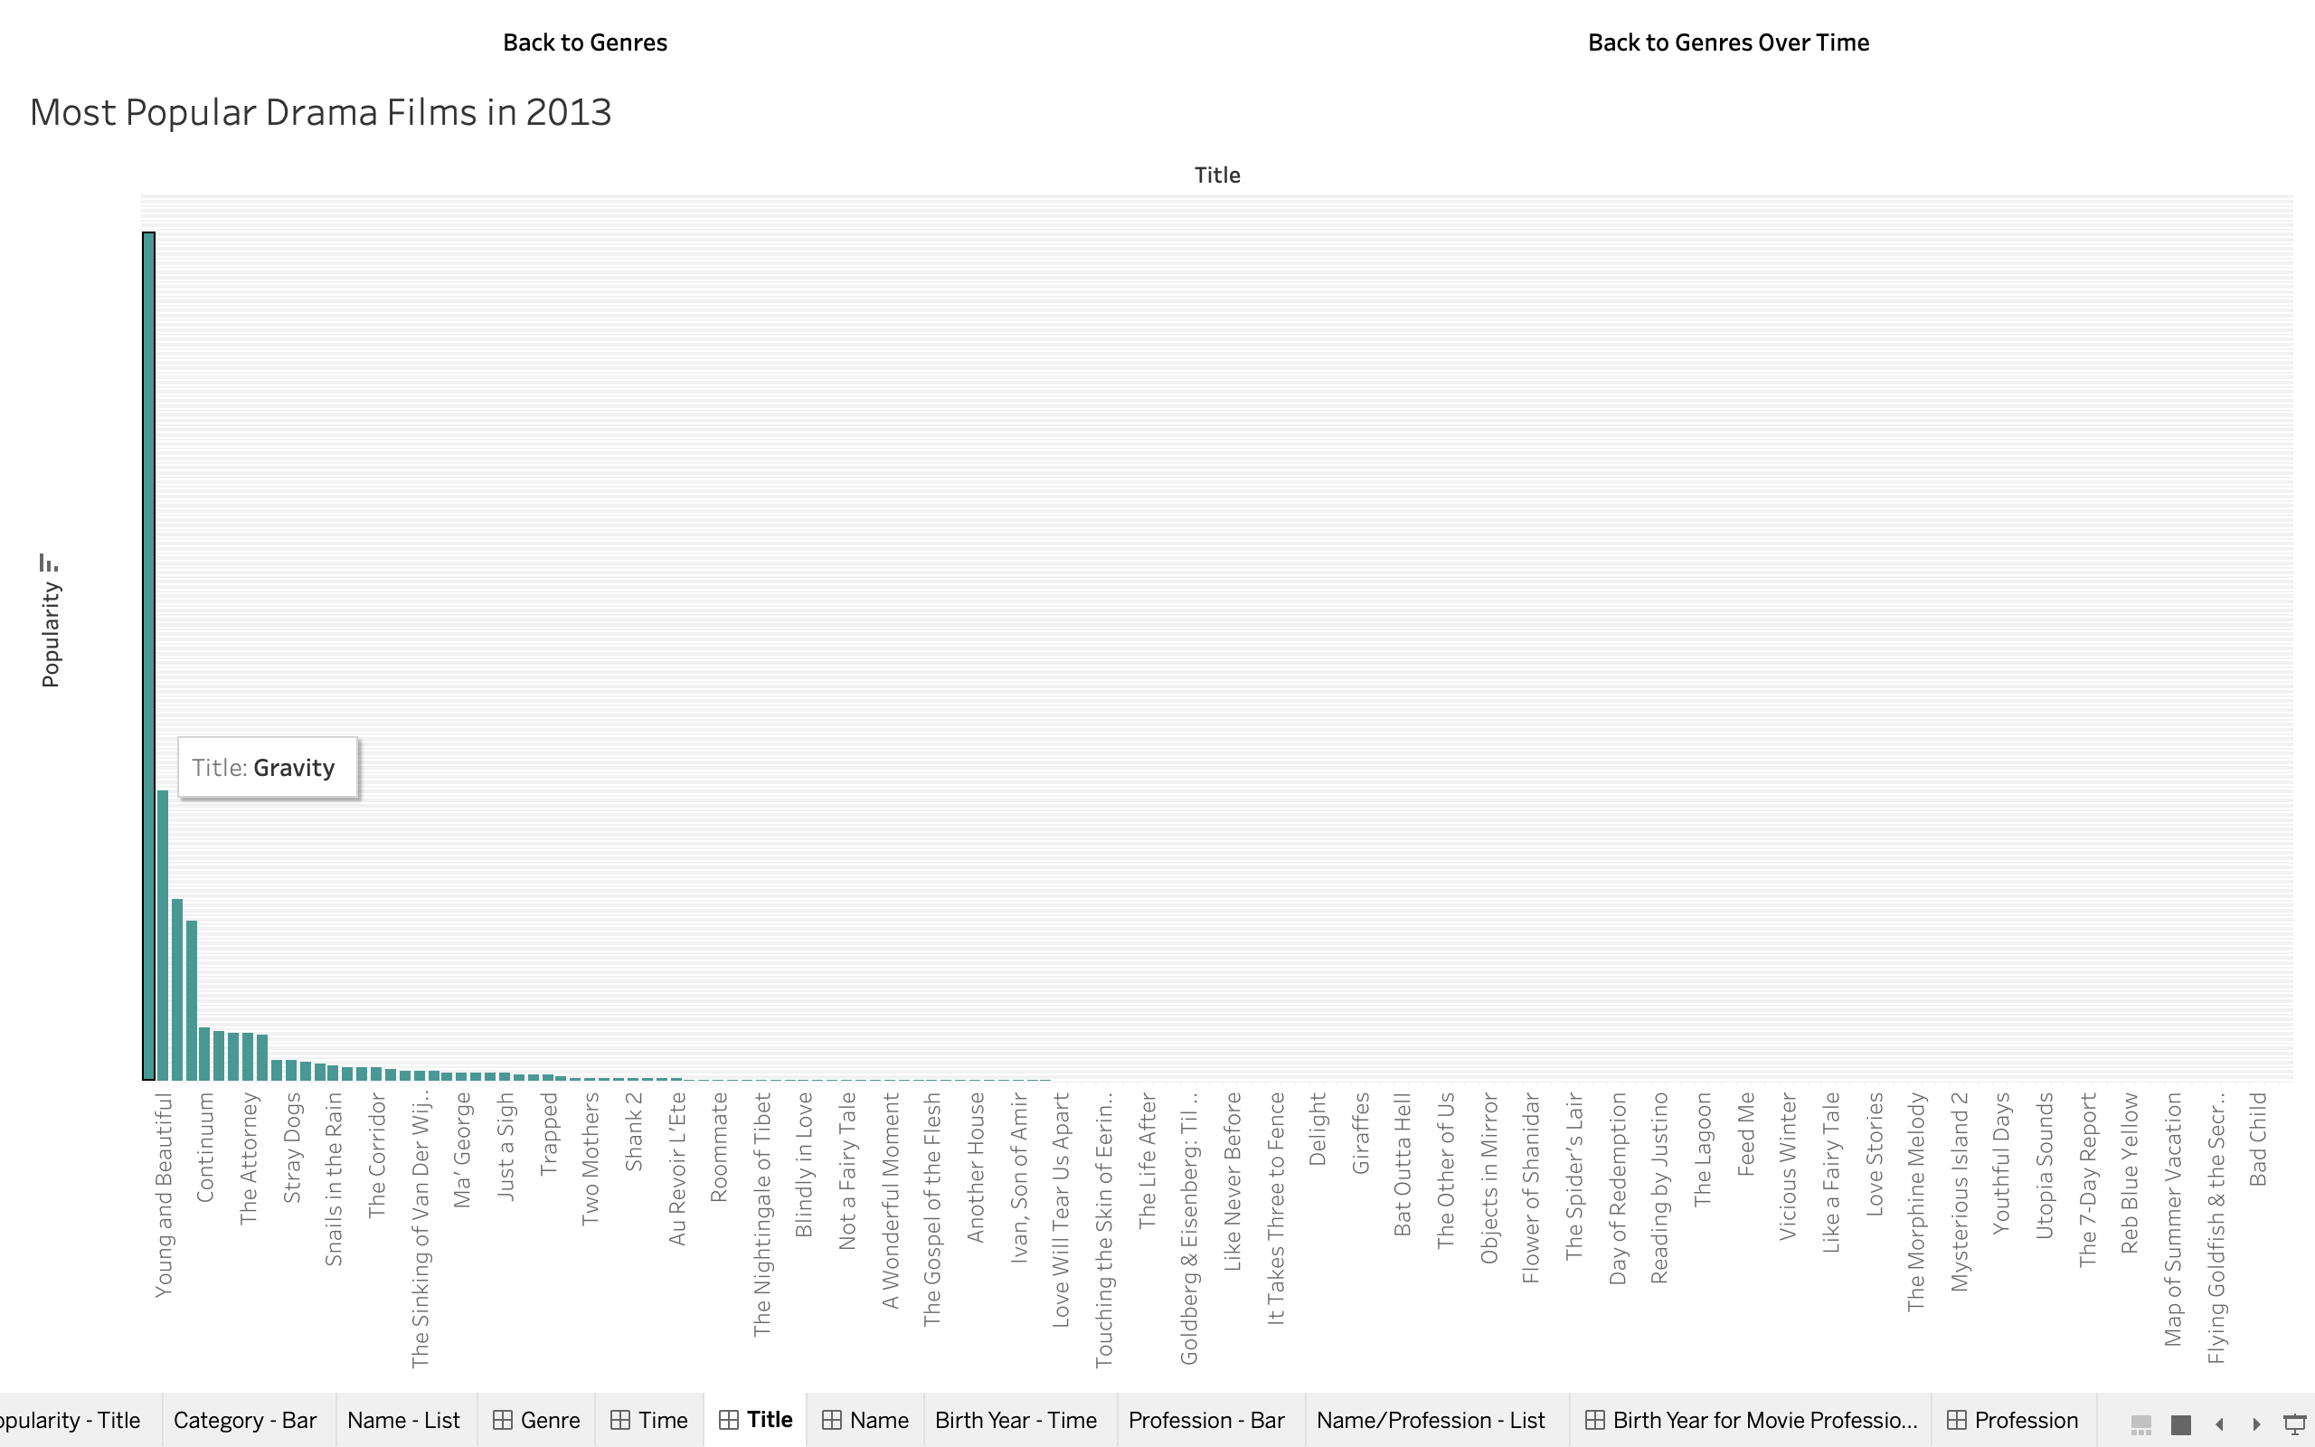

Slide 15
Tableau - Name
Once a year is clicked on from the previous dashboard, the user is taken to this dashboard
Genre and year displayed in title to clarify which data is being viewed
Dashboard consists of the number of people by category as well as a list of categories and the names of the people that belong each that category
Tooltip displays number of people and category
If a category is selected, list is filtered by that category
Slightly unnecessary since most titles tend to have a max of 10 people listed, but assuming that all the names were inputted, this feature would become a lot more useful
User can go back to any of the previous dashboards by clicking on the buttons at the top of the dashboard

Slide 16
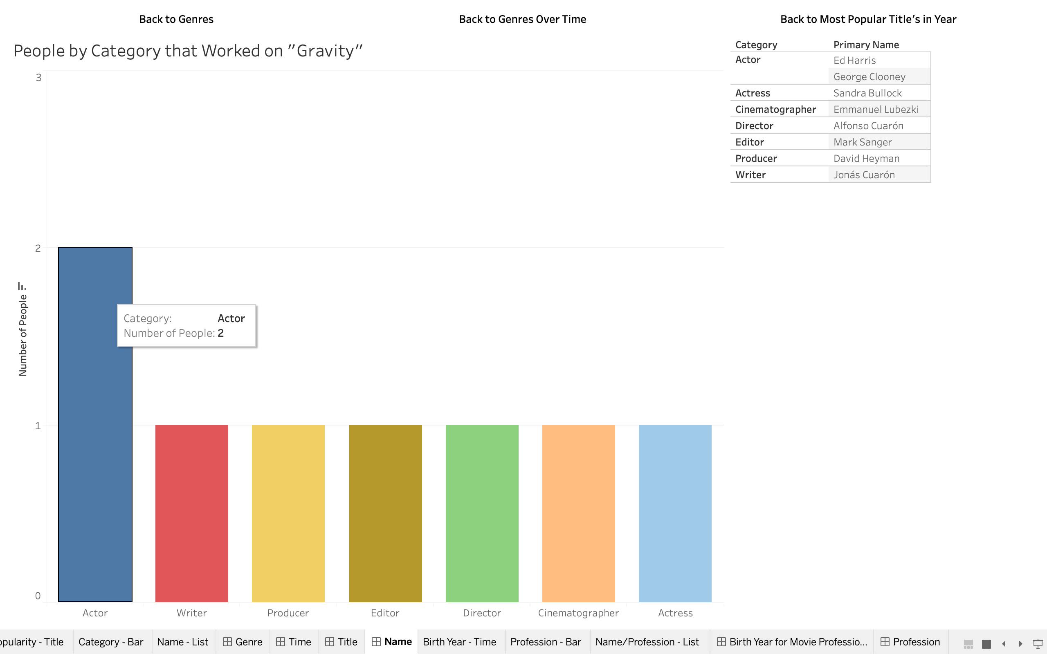

Slide 17
Tableau – Extra
The following dashboards are an additional piece that do not relate to any of the previous dashboards, but I thought were still fairly interesting
The first displays the number of people by the year they were born
If a year is selected, the user is taken to another dashboard that displays the number of people born in that year by their profession as well as a list of professions and the names of the people that belong to that category
Selecting a profession filters the list to only that profession

Slide 18
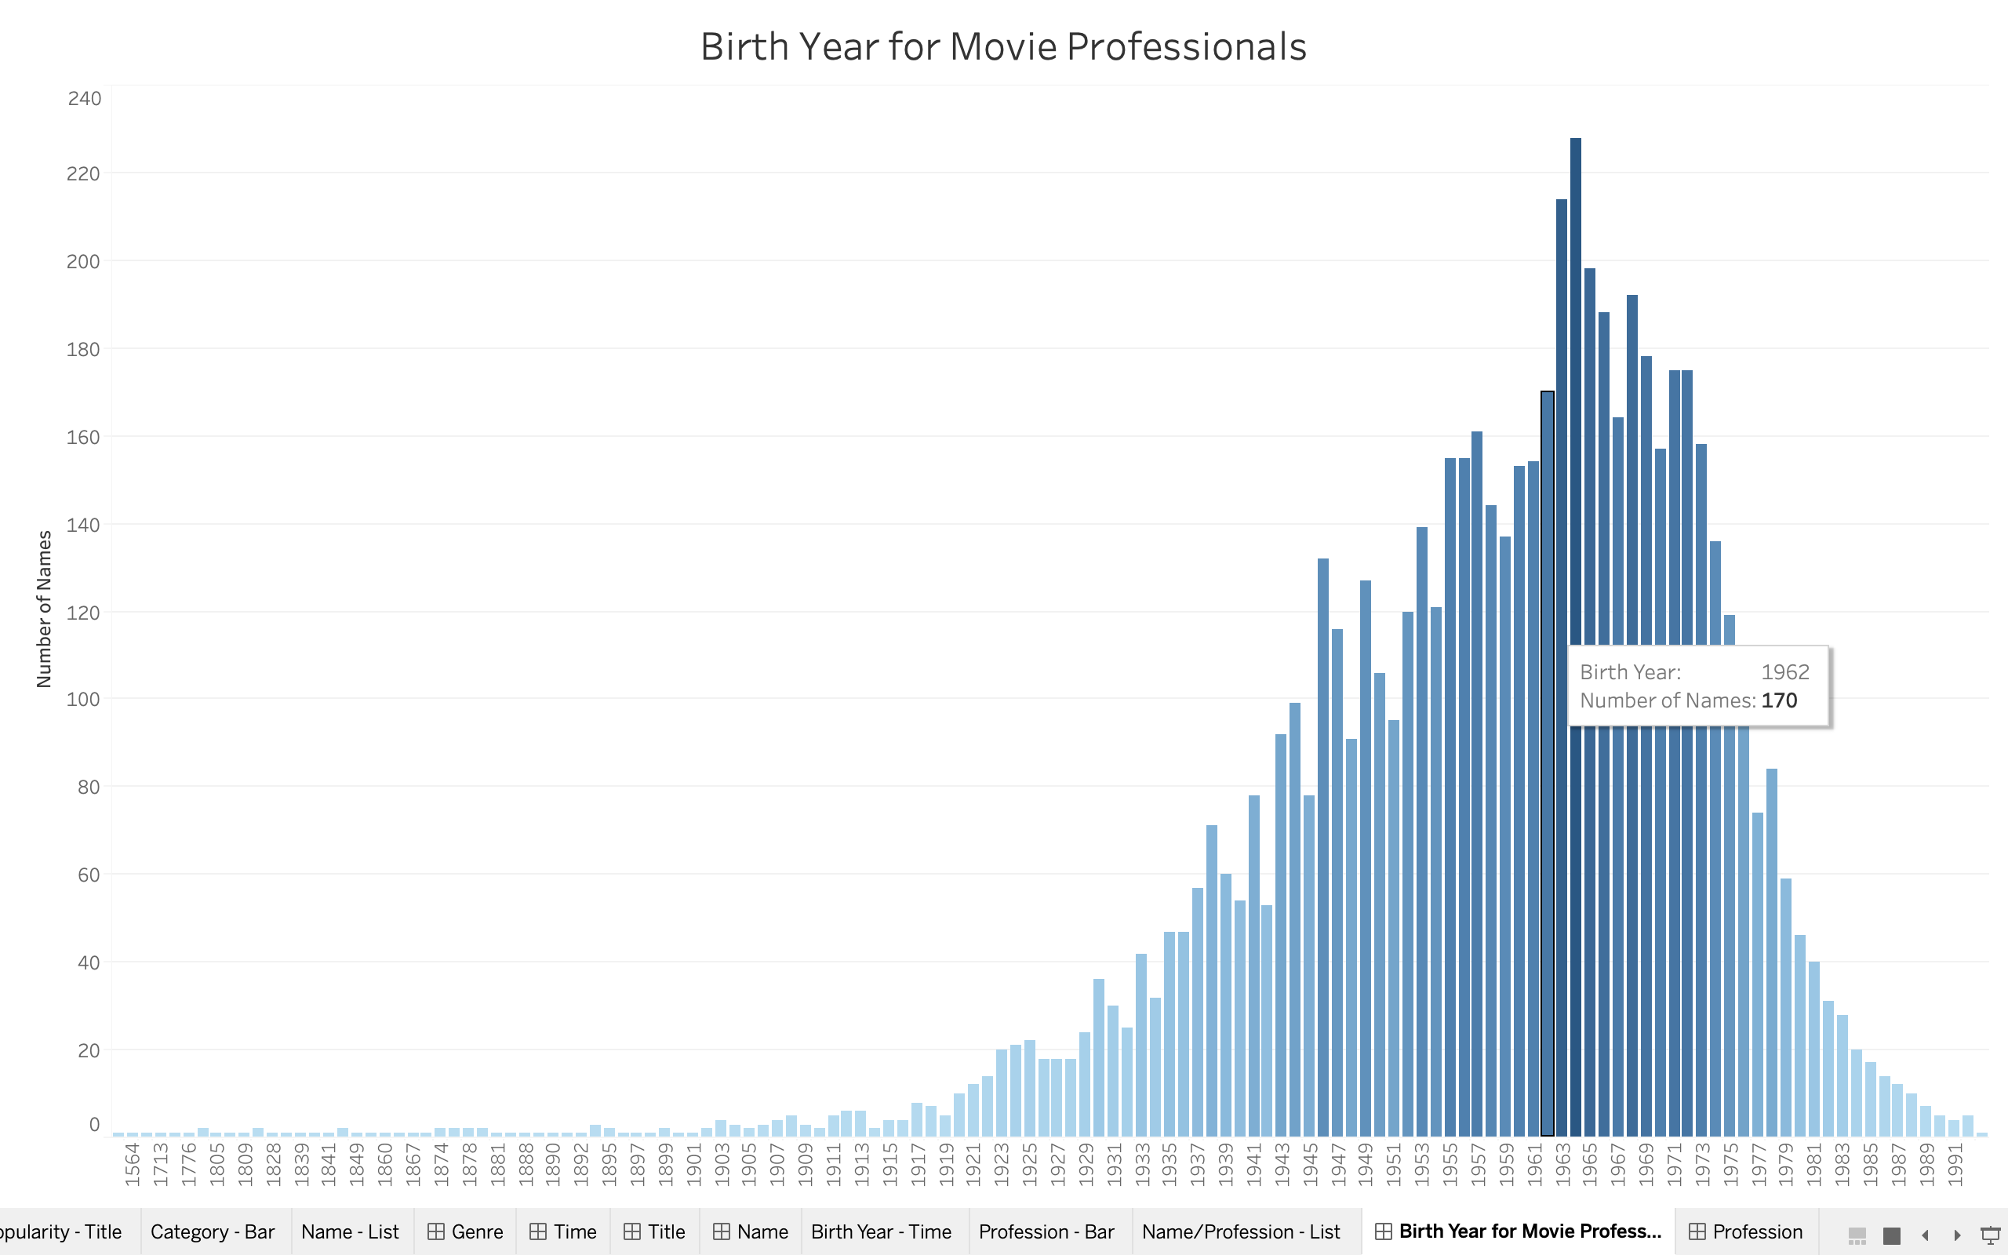

Slide 19
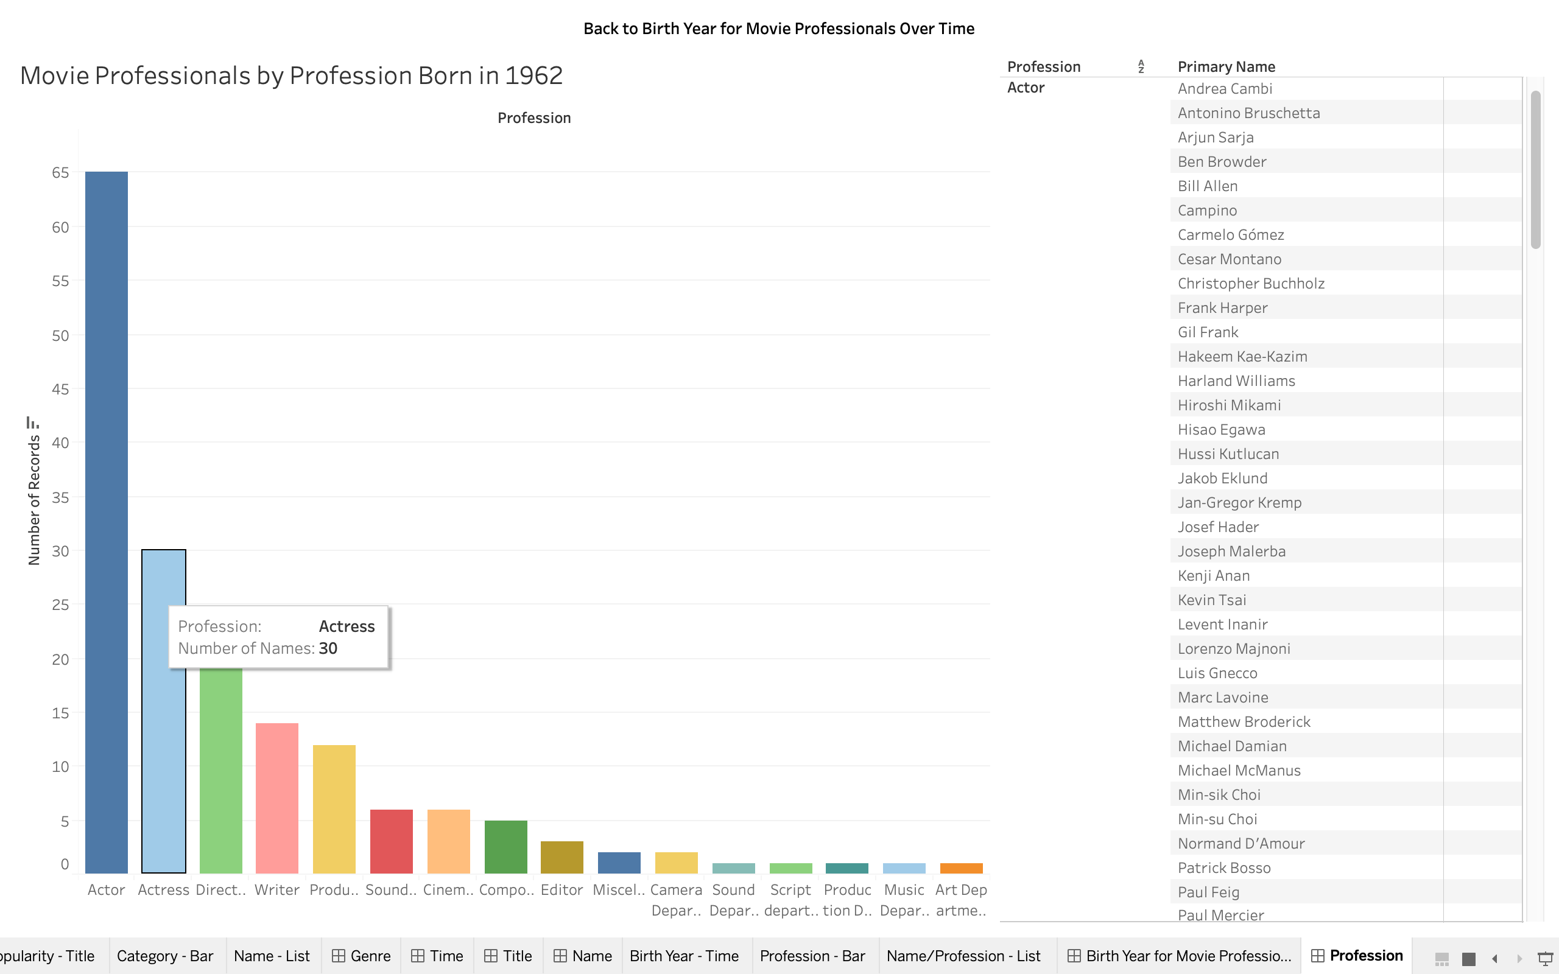

Slide 20
